Slide 1
Carbon Trading: A Cross-Sectoral Analysis of Allowance Pathways Under the EU ETS
Carbon Trading Global Stocktake Datathon (2022)
Abhinav Bhardwaj & Matthew Duyst
Yale University

Slide 2
Abstract
The EU Emissions Trading System (ETS) is a “cap-and-trade” policy that allocates countries’ greenhouse gas (GHG) outputs by setting a threshold (cap) on the maximum amount of emissions allowed within a given year.
ETS incentivizes countries to purchase emission “allowances” that must be traded or surrendered within a one-year timeframe. One allowance is equal to one tonne of Carbon Dioxide equivalent (CO2-eq)
GHG emissions are assessed at the sector-level.
The EU has amplified its net emission reduction goal to a minimum of 55% by 2030. To reach this target, a sector-wide reduction of 61% is required (an additional 18% in emission reductions compared to current sector-wide contributions).

Slide 3
Objective
Build an interactive, user-interface webtool that explores the relationship between allowance allocations and CO₂ emissions under the EU ETS.
Develop a movable ‘allowance decay rate’ slider (up to 30%) that computes forecasted emission values from 2022 to 2030 based on a user’s selected decay rate.
Provide sector-specific allowance and emission scenarios for countries operating within the EU ETS that quantifies required allowance volume reductions to reach 2030 emissions target.

Slide 4
Outcomes
Historical records of sector-specific country outputs in yearly CO₂ emissions under the EU ETS (2005 – 2021).
Movable forecasts of sector-specific country outputs in yearly CO₂ emissions (2022 – 2030) based on allowance decay rate slider.
Visual comparisons among countries’ emission rate pathways to isolate problematic sectors (energy-intensive and prone to carbon leakage) for re-distribution of allowance allocations.

Slide 5
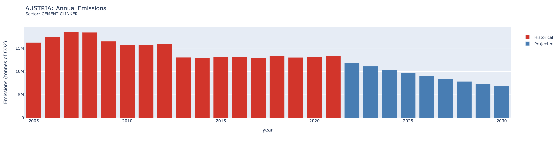
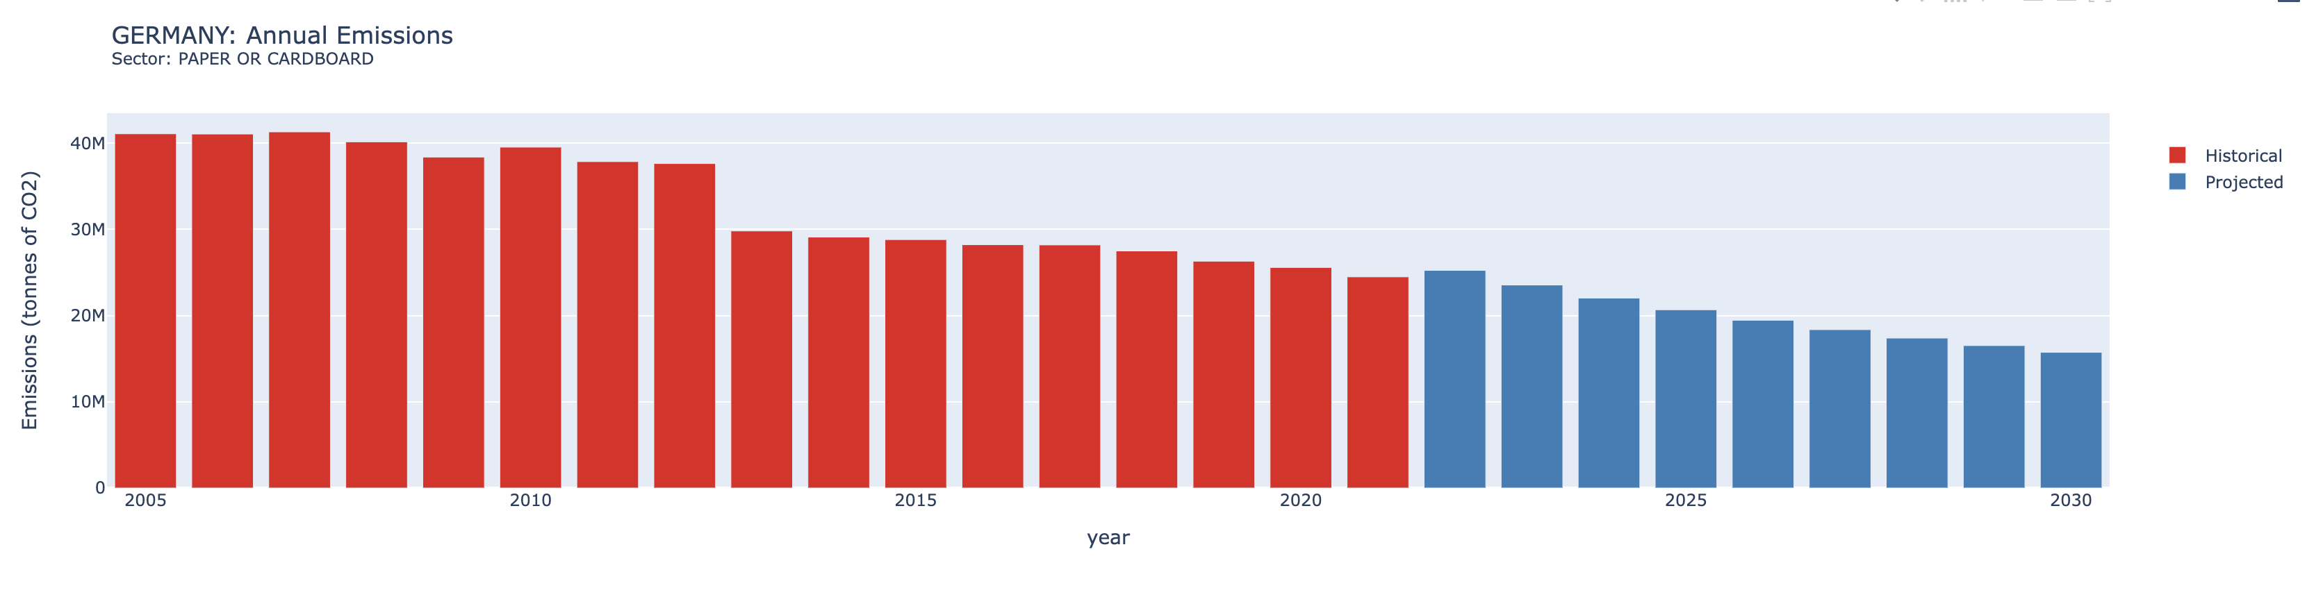
Visualization

Slide 6
